Slide 1
Free-Style Object Tracking using OpenCV APIs
AKASH GHIMIRE
THAPA PRADIP
PARIYAR BIJAY

Slide 2
Object tracking
Lactating an object in successive frames of video
The tracking procedure can be viewed as a combination of two models: the motion model and the appearance model.
Motion model : tracks the speed and direction of the object's movement, allowing it to forecast the object's new position based on the received data
Appearance model: responsible for verifying whether the object we've chosen is within the frame or not.

Slide 3
Difference between detecting an object and tracking
Tracking is faster than detection: While a pre-trained classifier must detect an item at every frame of the video, when we use an object tracker, we provide the bounding box of an object once and the tracking process is accelerated based on data about its location, speed, and direction.
Tracking is more stable: When the tracked object is partially hidden by another object, the detection method may "lose" it, whereas tracking algorithms are more resistant to partial occlusion.
Tracking provides more information: If we are not interested in whether an object belongs to a given class, the tracking algorithm may trace an object's movement path, however the detection algorithm cannot.

Slide 4
Different types of OpenCV object tracker
Boosting tracker
MIL (Multiple Instance Learning) Tracker
KCF (Kernelized Correlation Filters) Tracker
TLD (Tracking Learning Detection) Tracker
Median Flow Tracker
MOSSE (Minimum Output Sum of Squared Error) tracker
Kalman filter

Slide 5
Kalman Filter
The Kalman filter is a set of mathematical equations that provides an efficient computational(recursive) means to estimate the state of a dynamic system, in a way that minimizes the mean of the squared error
The filter is a very powerful in the sense that it supports estimations of past, present, and even future states and it can do so even when the precise nature of the modelled system is unknown

Slide 6
Kalman Filtering Algorithm
The main notion behind the Kalman filter is that it makes a forward projection state or forecasts the next state using prior knowledge of the state.
The Kalman Filter is designed to estimate the state of a system at time k using the linear stochastic difference equation under the assumption that the system's state at time k evolved from its previous state at time k-1. This equation is expressed as follows:
It is always paired with the measurement model zk that describes a relation between the state and measurement at the current step k. It is written as:
Where
A =state transition matrix relating the previous time step (k-1) to the current state k
B=control input matrix applied to the optional control input U(k-1) H= transformation matrix that transforms the state into the measurement domain Wk & Vk = represent the process noise vector with the covariance Q and the measurement noise vector with the covariance R, respectively

Slide 7
Applications
Tracking objects (e.g., missiles, faces, heads, hands)
• Fitting Bezier patches to (noisy, moving, ...) point data
• Economics
• Navigation
• Many computer vision applications
– Stabilizing depth measurements
– Feature tracking
– Cluster tracking
– Fusing data from radar, laser scanner and
stereo-cameras for depth and velocity measurements and many more

Slide 8
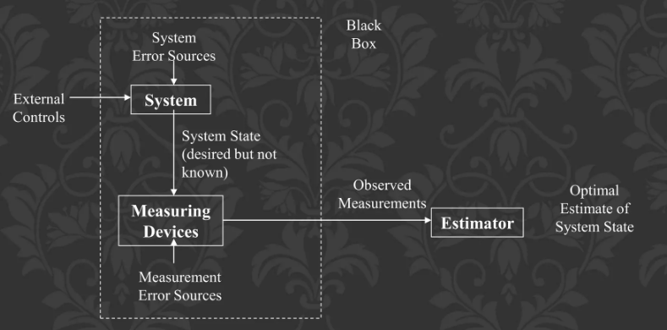
The problems
System state cannot be measured directly
Need to estimate “optimally” from measurements

Slide 9
How does Kalman filter works
The Kalman filter estimates the state of a dynamic system.
This dynamic system can be disturbed by some noise, mostly
assumed as white noise. To improve the estimated state, the
Kalman filter uses measurements that are related to the state
but disturbed as well.
Thus the Kalman filter consists of two steps:
1.The prediction
2. The correction

Slide 10
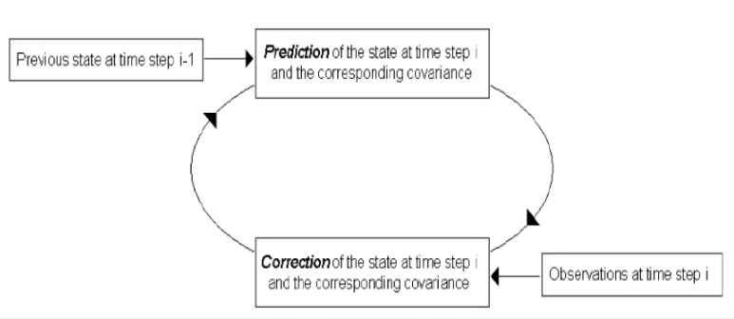
In the first step the state is predicted with the dynamic model.
In the second step it is corrected with the observation model, so that
the error covariance of the estimator is minimized. In this sense it is an
optimal estimator.
This procedure is repeated for each time step with the state of the
previous time step as initial value. Therefore the kalman filter is called
a recursive filter.

Slide 11
Problems with Kalman filters
It is very difficult to compute the covariance matrix of
noise of various sensors and systems
It is possible to do some trial and error fitting of error
matrix to the problem to "tune" the filter for performance
The filter needs to process several samples in order to get
enough iterations to produce meaningful results - You
need to discard the first 20 iterations or so when the filter
first starts.

